Slide 1
Detection of Parkinson’s disease using Extreme Gradient Boosting
Under Guidance of
Dr. L. V. Rajani Kumari
Assistant Professor
ECE Department
By
Mohammad Aatif Jaffery
K. Saketh Sai Nigam
G. Manaswi
P. Thrangini

Slide 2

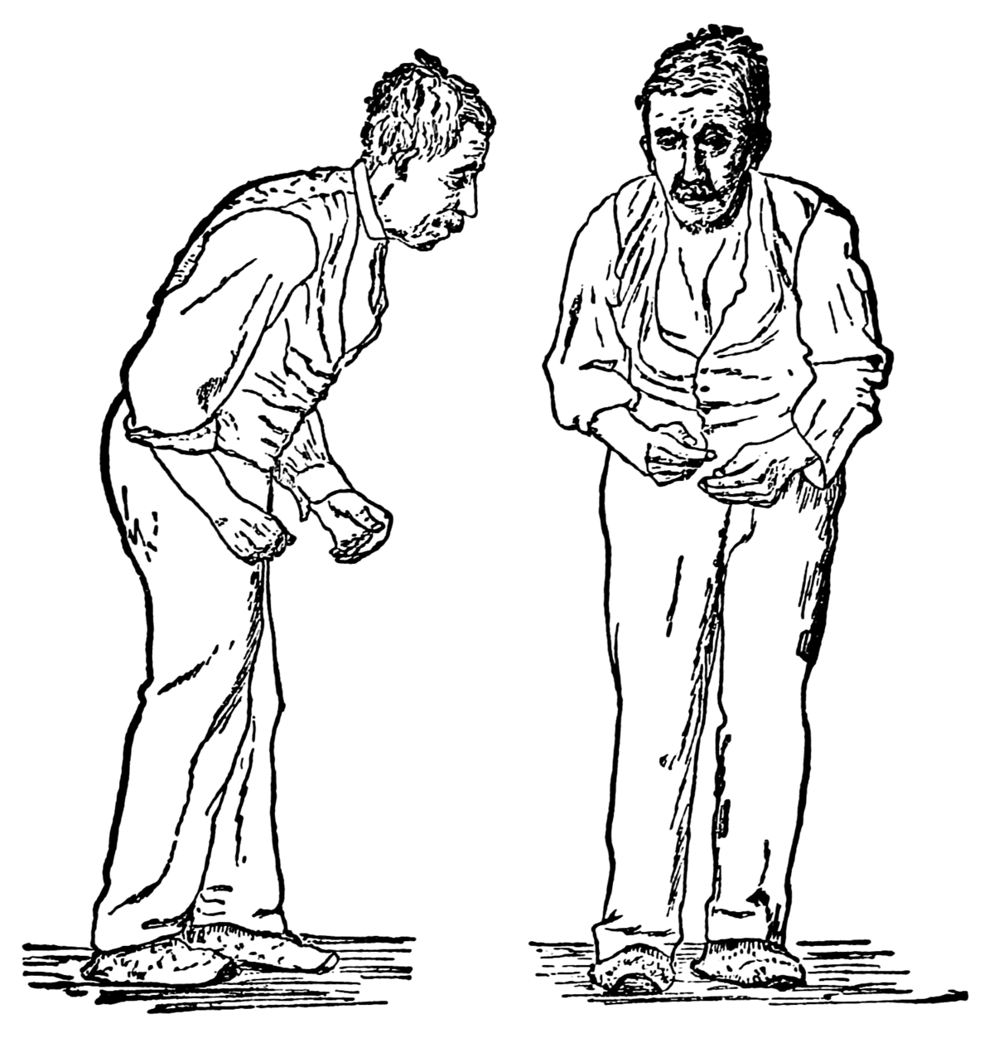

Introduction
Parkinson’s disease is a chronic progressive disease of the nervous system characterized by cardinal features of
Rigidity
Bradykinesia
Tremor and
Postural instability
General age of onset of symptoms is 60 years.
The most common speech problems experienced by people with PD involve
Hypophonia
Reduced monotone and
Dysarthria

Slide 3
Introduction
Parkinson’s disease affected patients may exhibit word finding difficulties and grammatical difficulties.
They tend to increase the frequency and duration of hesitations and pauses.
Affected person’s experience difficulties in both production and comprehension of language.
The usual treatment used for PD patients to overcome speech problems are
Behavioral Speech Therapy
Lee Silverman Voice Therapy ( LSVT )

Slide 4
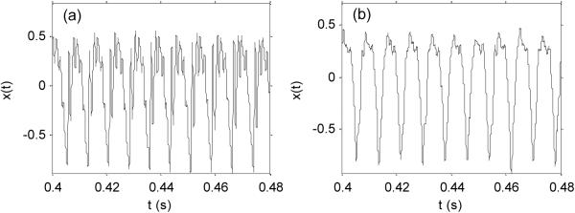
Normal vs Parkinson’s person audio recording

Slide 5
MOTIVATION
Parkinson’s Disease is the second most common age-related neurodegenerative disorder after Alzheimer’s disease.
An estimated seven to 10 million people worldwide have Parkinson’s disease.
The disease affects patients’ quality of life, making social interaction more difficult and worsening their financial condition, due to the medical expenses associated with the disease.
The above statistics were reported by Parkinson’s news today

Slide 6
AIM OF THE PROJECT
Detection of Parkinson’s Disease in a person using Extreme Gradient Boosting to obtain a highest possible accuracy.

Slide 7
WORKFLOW OF THE PROJECT
Data Collected from UCI Database
Feature selection
Decompose into Train & Test Dataset
XGBoost Classifier
Normal
Parkinson

Slide 8
DATASET
The dataset was collected from the UCI Machine Learning Repository.
In this dataset the audio recording of 31 persons in which 23 are Parkinson’s affected and 8 are normal persons.
So, we obtained a dataset of 194 rows data in which 147 are audio recordings of Parkinson’s patient.
The dataset has 24 columns are the features that are extracted from the audio signals.
status - Health status of the subject (one) - Parkinson's, (zero) - healthy
We developed our model by dividing the Dataset into Training and Testing.
For training the model, we used 70% of the dataset that is 135 from overall dataset.
For testing the model, we used 30% of the dataset that is 59 from overall dataset.
Parkinson’s affected | 101
Healthy | 34
Parkinson’s affected | 46
Healthy | 13

Slide 9
XGBoost CLASSIFIER
The classifier we used to develop our model is Extreme Gradient Boost classifier Shortly known as XGBoost.
XGBoost Classifier is a decision-tree-based ensemble Machine Learning algorithm that uses a gradient Boosting framework.
A wide range of applications: Can be used to solve regression, classification, ranking, and user-defined prediction problems.
XGBoost improves upon the base Gradient Boosting Machine framework through systems optimization and algorithmic enhancements.

Slide 10
PERFORMANCE EVALUATION
CONFUSION MATRIX
N=59 | Actual Normal | Actual Parkinson’s
Predicted Normal | 13 | 0
Predicted Parkinson’s | 2 | 44

Slide 11
RESULTS
PERFORMANCE PARAMETER | OBTAINED VALUE
Accuracy | 96.61%
Sensitivity | 95.6%
Specificity | 100%
Precision | 100%
F-Score | 97.7%

Slide 12
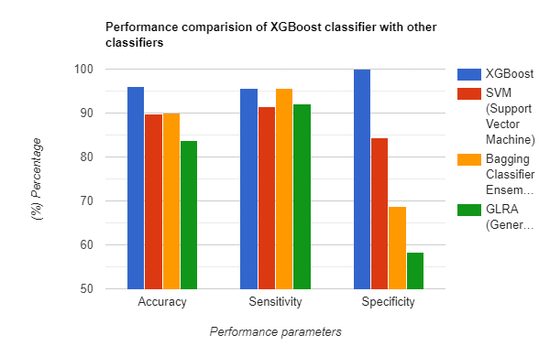
Comparison with Another classifier

Slide 13
CONCLUSION
Built a model with an Extreme Gradient Boost Classifier and achieved an accuracy of 96.61% .

